Slide 1


Autonomous grading system for Sinhala Language Essays of grade 5 students
R24-088
R24-088

Slide 2


Content
Introduction
Research Problem
Objectives
System Overview Diagram
Technologies
Individual Components

Slide 3



1.Introduction
Highlight the significance of an autonomous grading system in evaluating Sinhala essays of grade 5 students
Remedy for the challenges faced in traditional manual grading processes
Specific focus on Sinhala language and importance of addressing language proficiency
3

Slide 4

2. Research Problem
How to provide mobile application based solution on ,
autonomous grading system for Sinhala Language Essays of grade 5 students ?
4

Slide 5
3.Objectives
Main Objective
Create a grading system for Sinhala Language essays of grade 5 students
Sub Objectives
Identifying native words and replace them with more generic words
Misspelled Words Detection and Correction
Check the Grammar rules in the sentence
Provide general feedback by improving the answer
5

Slide 6
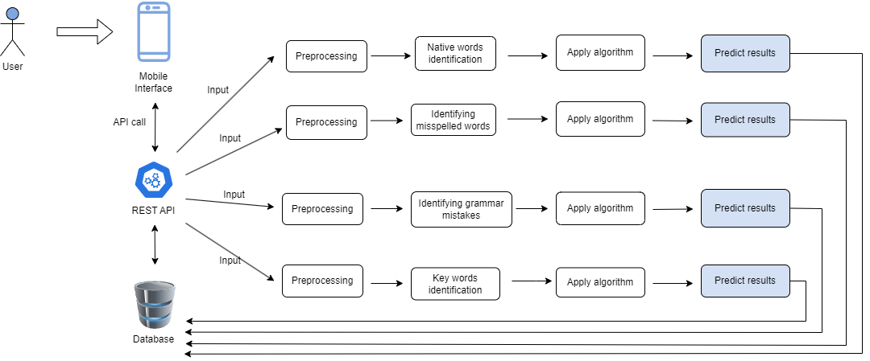
4. System Overview Diagram
4. System Overview Diagram
6

Slide 7

5.Technologies
Mobile Application
Android
Database
Firebase
Middle Ware Technologies
Python
Jupyter
REST API
Technical Concepts
Natural Language Processing
Machine Learning
7

Slide 8
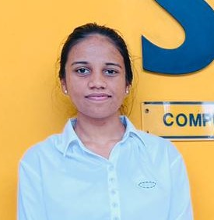
IT21007538 | Maddumage P.W.
BSc (Hons) Degree in Information Technology (specialization in Data Science)
IT21007538 | Maddumage P.W. | R24-088
8

Slide 9

Component 1
Identifying native words and replace them with generic words
IT21007538 | Maddumage P.W. | R24-088
9

Slide 10
Background
Native words, often specific to a particular region, can pose challenges in terms of comprehension and universality.
Process involves recognizing words unique to a specific linguistic context and substituting them with more generally understood terms.
IT21007538 | Maddumage P.W. | R24-088
10

Slide 11
Research Question
"How to identify native words in Sinhala and replace them with general words ?”
IT21007538 | Maddumage P.W. | R24-088
11

Slide 12
Specific and sub objectives
Specific Objective
Identifying native words and replace them with generic words
Sub Objectives
Making data corpus specific to Sinhala native words
Identifying native nouns and verbs and replace them with generic words
IT21007538 | Maddumage P.W. | R24-088
12

Slide 13
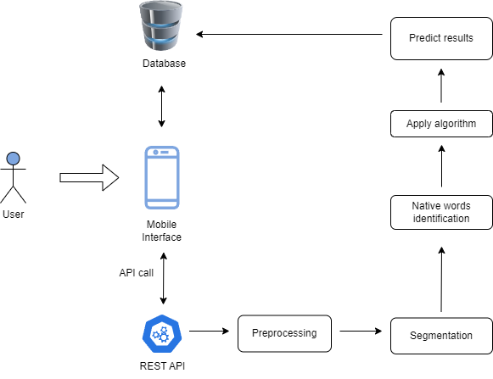
Methodology
Component Overview Diagram
IT21007538 | Maddumage P.W. | R24-088
13

Slide 14

Achievement of 50%
Collected data corpuses separately for
native verbs and nouns
Implemented frontend of the login function
of the mobile application
IT21007538 | Maddumage P.W. | R24-088
14

Slide 15


Usage of technologies and tools in the relevant area
Task | Tools
Data preprocessing, algorithm generation | PyCharm
Mobile Application | Android Studio
IT21007538 | Maddumage P.W. | R24-088
15

Slide 16
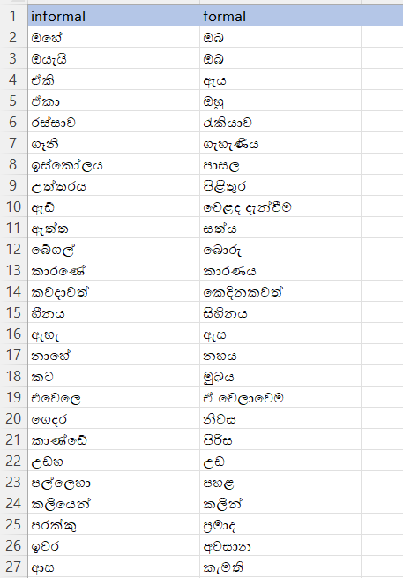
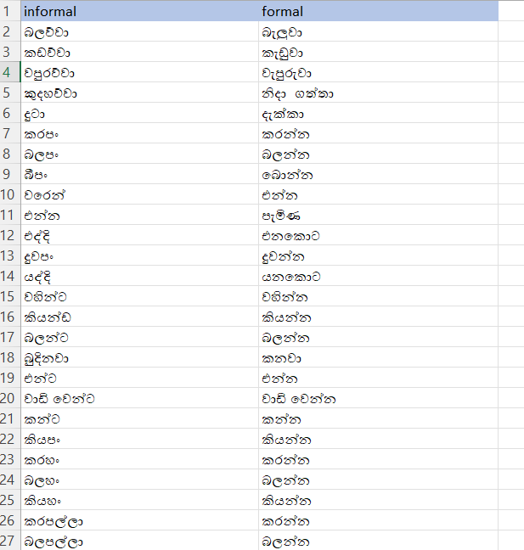
Collected Data Set
IT21007538 | Maddumage P.W. | R24-088
16

Slide 17
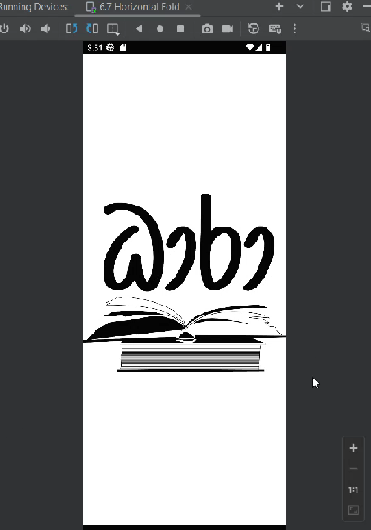
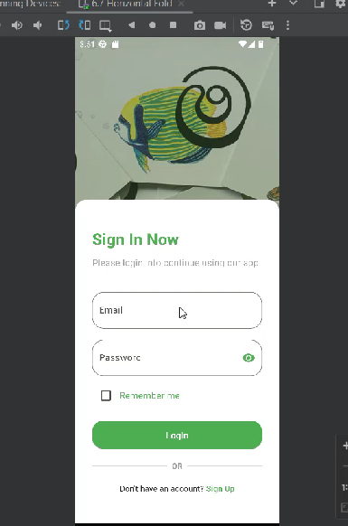
Mobile Application
IT21007538 | Maddumage P.W. | R24-088
17

Slide 18
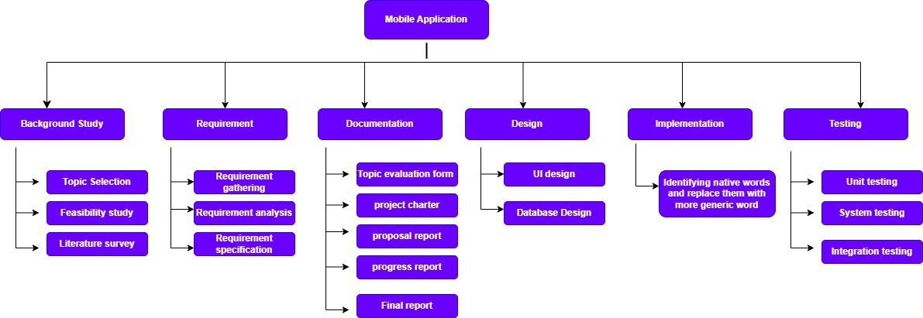
Work breakdown diagram
IT21007538 | Maddumage P.W. | R24-088
18

Slide 19
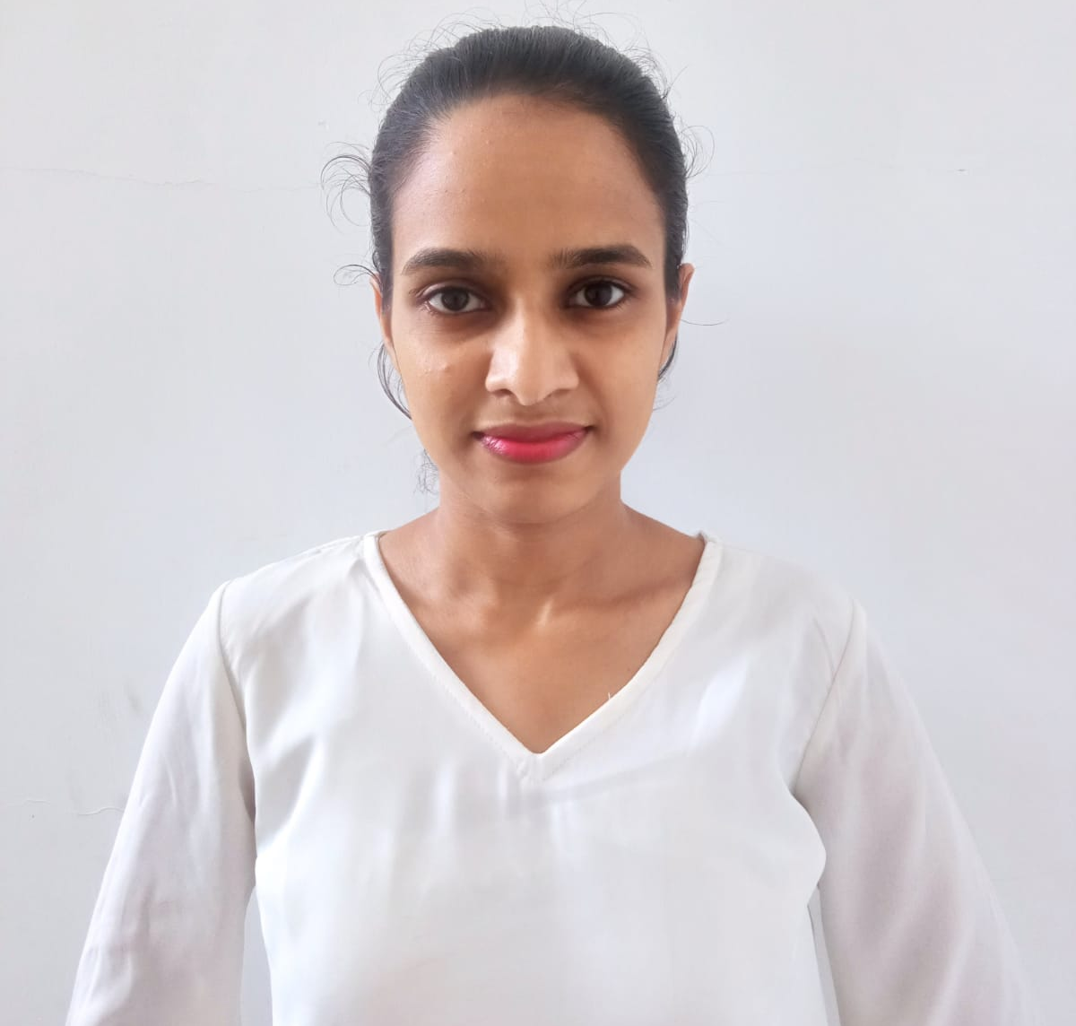
IT21006098 | Wijesinghe W.M.C.I.
BSc (Hons) Degree in Information Technology (specialization in Information technology)
IT21006098 | Wijesinghe W.M.C.I. | R24-088
19

Slide 20
Misspelled Words &
Complex Words
Detection and Correction
Component 2
IT21006098 | Wijesinghe W.M.C.I. | R24-088
20

Slide 21
Background
Goal is to help Grade 5 scholarship students improve their Essay writing skills
Focusing on detecting and fixing misspelled words in the essay
Correct spellings is essential for a good grade
IT21006098 | Wijesinghe W.M.C.I. | R24-088
21

Slide 22
Research Question
How to detect misspelled words and correct them ?
IT21006098 | Wijesinghe W.M.C.I. | R24-088
22

Slide 23
Specific Objective
Misspelled Words Detection and Correction
Sub Objectives
Create a word corpus for Misspelled Words of Sinhala Language
Complex words detection
Specific and sub objectives
IT21006098 | Wijesinghe W.M.C.I. | R24-088
23

Slide 24
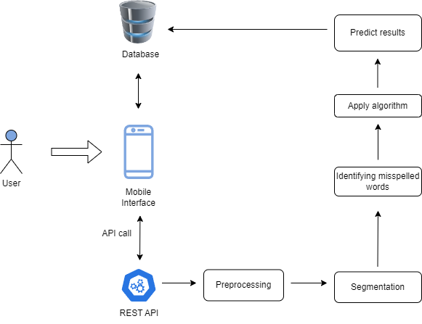
Methodology
Component Overview Diagram
IT21006098 | Wijesinghe W.M.C.I. | R24-088
24

Slide 25
Achievement of 50%
Collected data corpuses for
misspelled words
Collected data corpuses for
complex words
Implemented frontend of the login function
of the mobile application
IT21007538 | Maddumage P.W. | R24-088
25

Slide 26
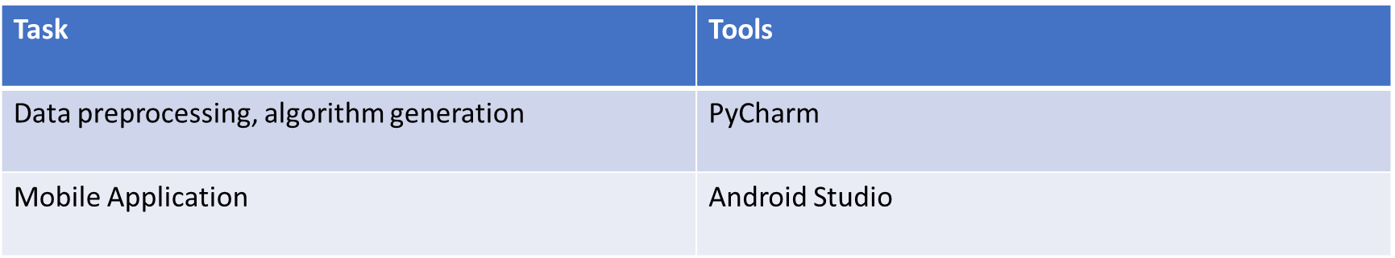
Usage of technologies in the relevant area
IT21007538 | Maddumage P.W. | R24-088
26

Slide 27
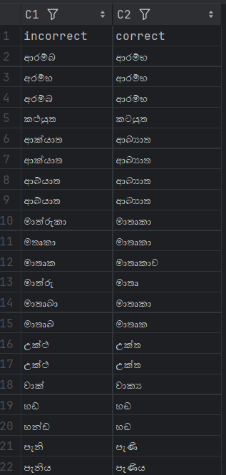
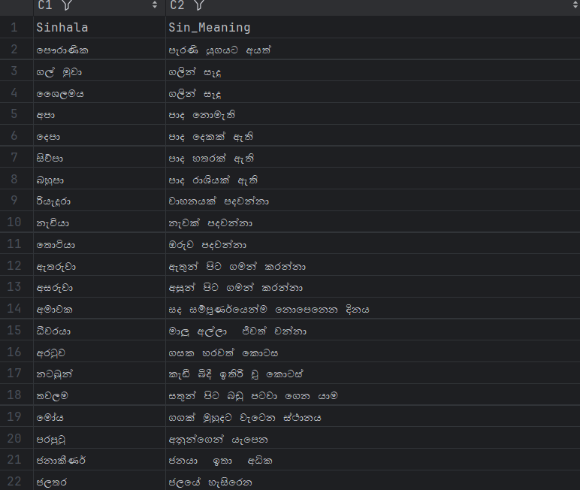
Collected Data Set
IT21007538 | Maddumage P.W. | R24-088
27

Slide 28
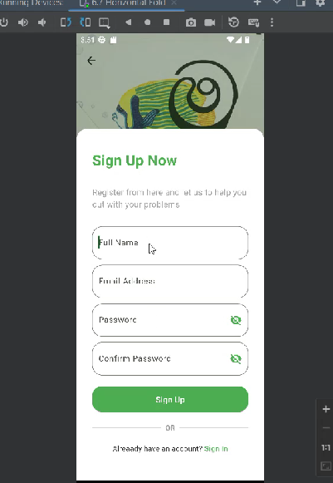
UI designs
IT21007538 | Maddumage P.W. | R24-088
28

Slide 29
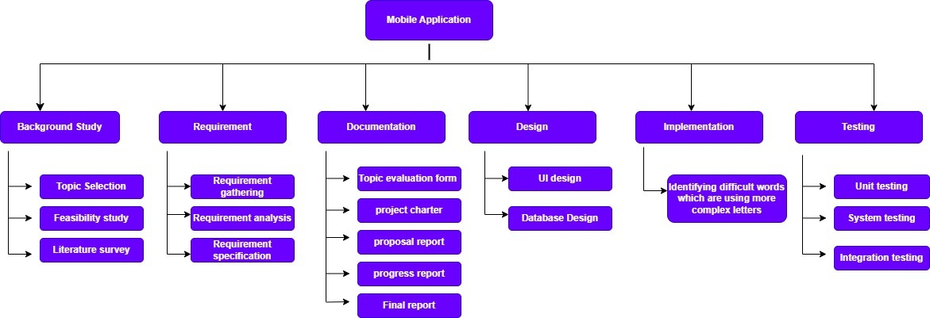
Work breakdown diagram
IT21006098 | Wijesinghe W.M.C.I. | R24-088
29

Slide 30
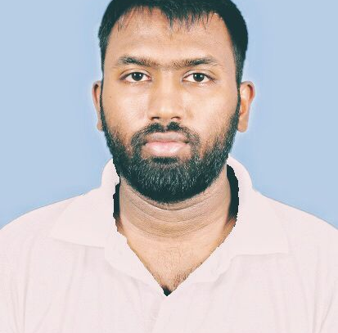
IT20604394 | Amarasena J.H.T.
BSc (Hons) Degree in Information Technology (specialization in Information Technology)
IT20604394 | Amarasena J.H.T. | R24-088
30

Slide 31
Check the Grammar rules in the sentence
Component 3
IT20604394 | Amarasena J.H.T. | R24-088
31

Slide 32
Check the grammar mistakes and correcting them
Background
IT20604394 | Amarasena J.H.T. | R24-088
32

Slide 33
How to identify the grammatical error in the sentence?
Research Question
IT20604394 | Amarasena J.H.T. | R24-088
33

Slide 34
Specific Objective
Check the Grammar rules in the sentence
Sub Objectives
Grammar Rule Identification
Correcting grammar mistakes
Specific and sub objectives
IT20604394 | Amarasena J.H.T. | R24-088
34

Slide 35

Methodology
Component Overview Diagram
IT20604394 | Amarasena J.H.T. | R24-088
35

Slide 36
Achievement of 50%
Gathered grammar rules of Sinhala Language
and developed a mechanism for check grammar rules
Implemented frontend of the login function
of the mobile application
IT21007538 | Maddumage P.W. | R24-088
36

Slide 37

Usage of technologies in the relevant area
IT21007538 | Maddumage P.W. | R24-088
37

Slide 38
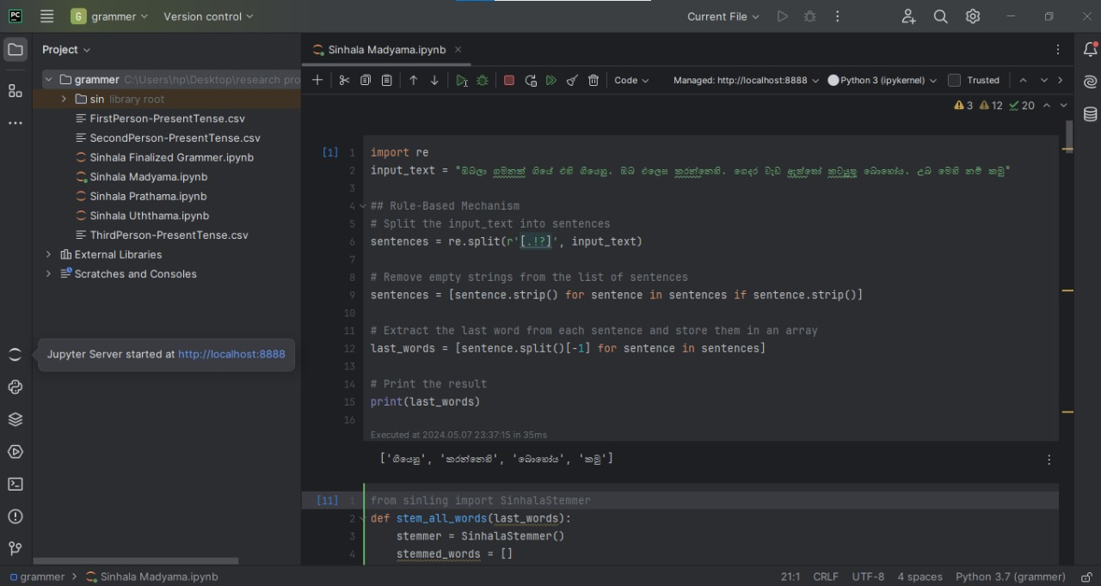
Developed algorithm
IT21007538 | Maddumage P.W. | R24-088
38

Slide 39
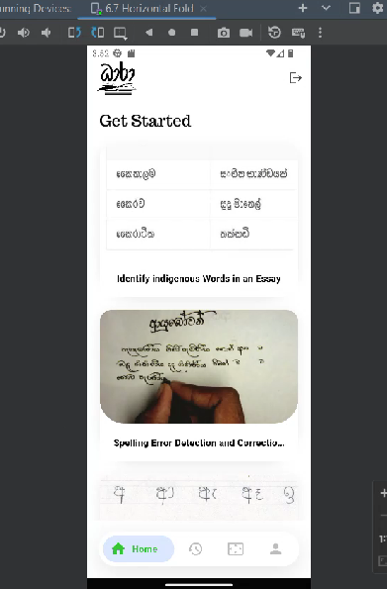
UI designs
IT21007538 | Maddumage P.W. | R24-088
39

Slide 40

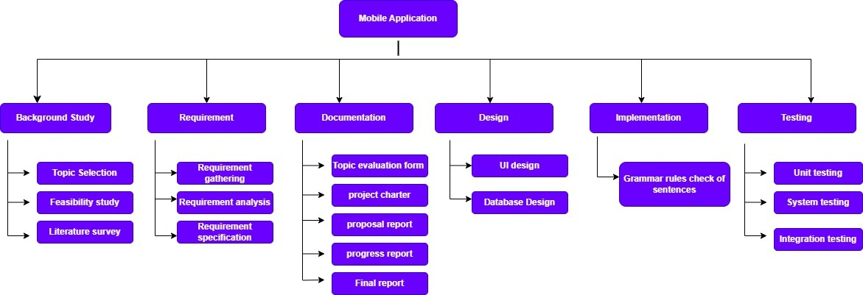
IT20604394 | Amarasena J.H.T. | R24-088
40

Slide 41
Evaluate generalized answer
Component 4
IT20124144 | Pindeniya P.C.M. | R24-088
41

Slide 42
Background
Comparing the keywords of the entered essay with the keywords of the system.
Marking for student's answer.
IT20124144 | Pindeniya P.C.M. | R24-088
42

Slide 43
Research Question
How to evaluate generalized answer?
IT20124144 | Pindeniya P.C.M. | R24-088
43

Slide 44
Specific Objective
Evaluate generalized answer
Sub Objectives
Defining the keywords in the essay and comparing them with the keywords in the system.
Awarding marks as the final result to the entered essay
Specific and sub objectives
IT20124144 | Pindeniya P.C.M. | R24-088
44

Slide 45
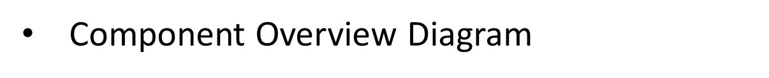

Methodology
IT20124144 | Pindeniya P.C.M. | R24-088
45

Slide 46
Achievement of 50%
Developed key word matching algorithm
for collected essays
Collected essays for data gathering
UI design
IT21007538 | Maddumage P.W. | R24-088
46

Slide 47
Usage of technologies in the relevant area
IT21007538 | Maddumage P.W. | R24-088
47

Slide 48
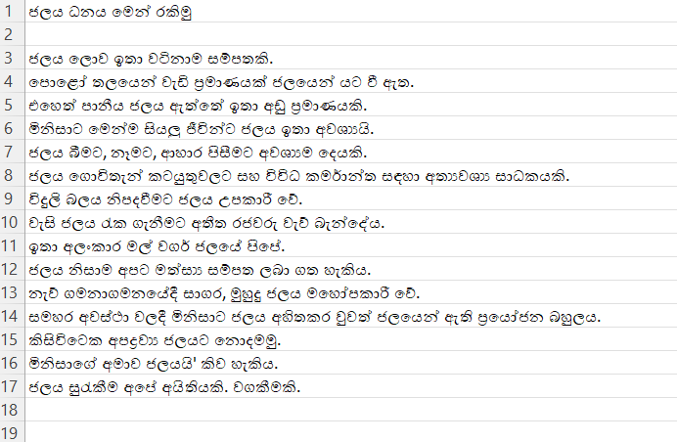
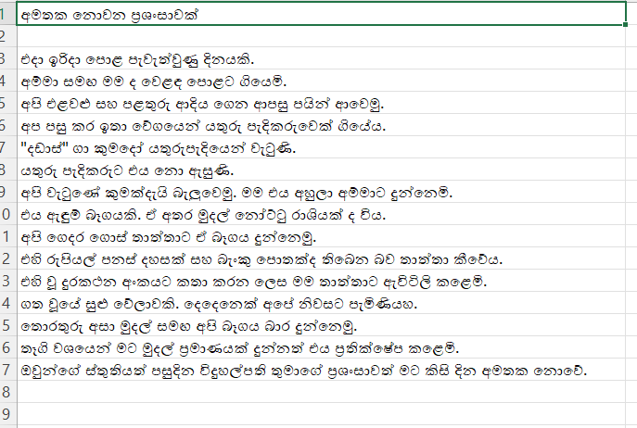
Collected Data Set
IT21007538 | Maddumage P.W. | R24-088
48

Slide 49
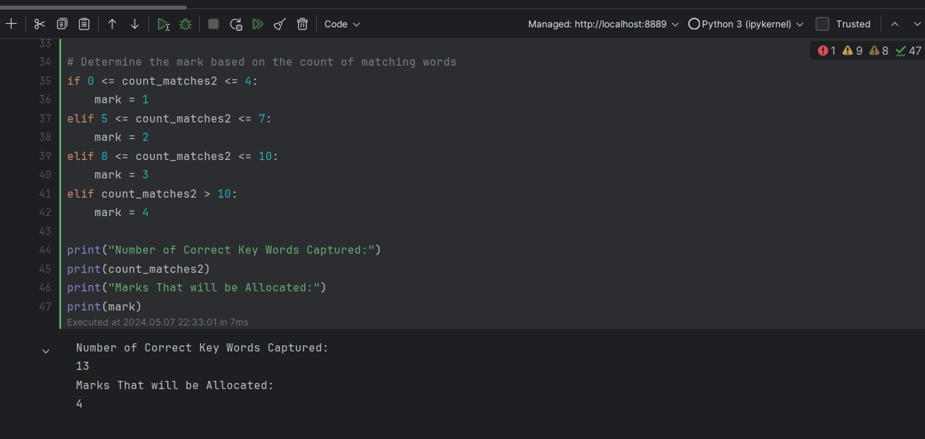
Developed algorithm
IT21007538 | Maddumage P.W. | R24-088
49

Slide 50

IT20124144 | Pindeniya P.C.M. | R24-088
50

Slide 51
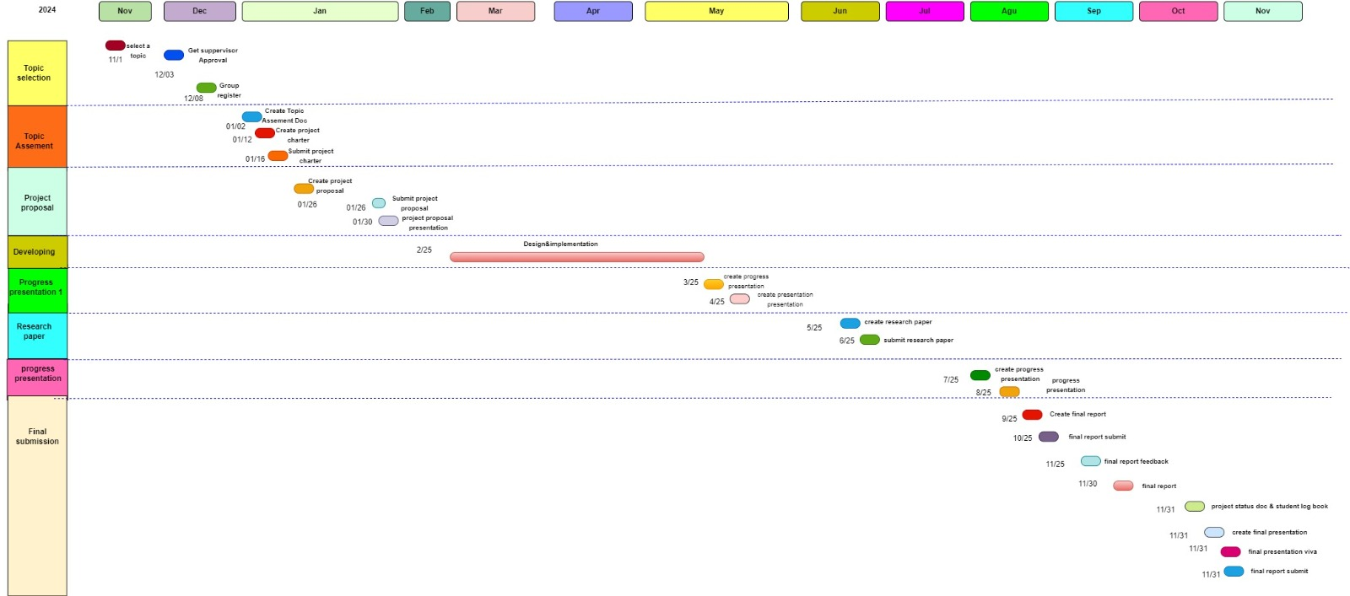
8.Gantt Chart
51

Slide 52
THANK YOU
52

